Slide 1

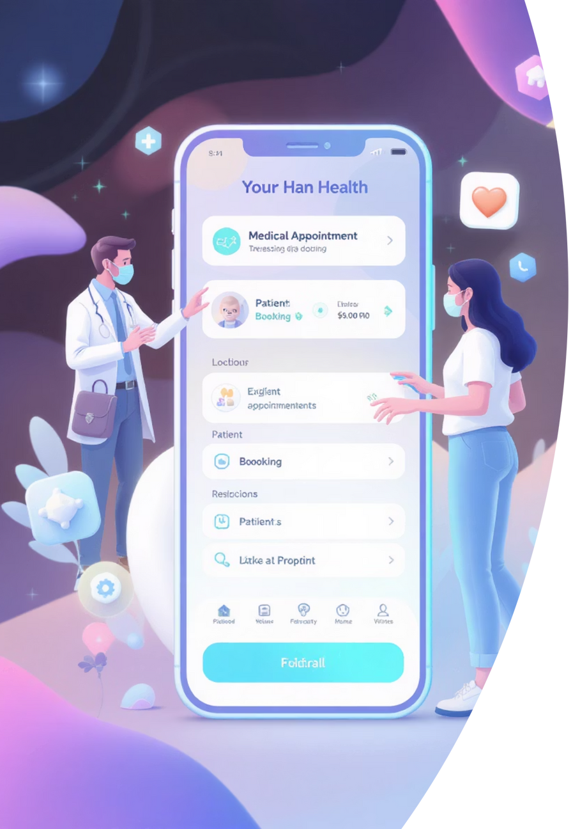
DocSpot: Online Doctor Appointment System
DocSpot is an intelligent platform designed to streamline doctor appointment bookings, enhancing interactions between patients, doctors, and administrators through a comprehensive digital ecosystem. Our focus is on modernizing healthcare workflows, offering secure authentication, personalized dashboards, efficient appointment tracking, and integrated document management.
Notes:
1

Slide 2
Problem Statement
Fragmented Processes
Lack of Centralization
Manual systems often lead to fragmented data, causing delays, miscommunication, and lost information in appointment scheduling.
Without a centralized system, managing appointments becomes chaotic, increasing administrative burden and reducing overall efficiency.
Trust & Verification Gaps
Document Management Woes
Absence of digital verification for healthcare providers can erode patient trust and introduce security risks.
Patients struggle with secure storage and convenient sharing of critical medical documents, hindering coordinated care.
Notes:
2

Slide 3





DocSpot: The Comprehensive Solution
Streamlined Online Booking
Dynamic Role-Based Dashboards
Rigorous Doctor Verification
Facilitates easy appointment scheduling with integrated options for secure file and document uploads, enhancing preparation for consultations.
An administrative approval mechanism ensures that all doctors on the platform are verified, maintaining high standards of quality and trust.
Customized interfaces for patients (booking, document management), doctors (appointment review, schedule control), and administrators (doctor approvals, analytics).
Secure & Intuitive Interface
Developed with a responsive UI, featuring modern design principles and smooth animations for an engaging and secure user experience.
Notes:
3

Slide 4
Tech Stack Used
Frontend
Backend
React.js (Vite) for rapid development and optimized performance.
Node.js + Express.js for a scalable and high-performance server.
Tailwind CSS + Framer Motion for responsive design and seamless animations.
MongoDB + Mongoose for flexible and robust database operations.
Axios for efficient and reliable API communication.
JWT for secure authentication and bcrypt for strong password hashing.
Tools & Deployment
GitHub for version control and collaborative development.
Netlify for swift frontend deployment.
Render/Heroku for reliable backend hosting and scalability.
Notes:
4

Slide 5



Project Workflow
User Flow
Data Flow
1
Patient Engagement
Frontend Requests
Patients register or log in and seamlessly browse available doctors.
The frontend sends structured requests to the RESTful API.
Backend Processing
2
Appointment & Upload
The backend efficiently handles authentication and manages database interactions.
Patients book appointments and conveniently upload relevant medical files.
Data Storage
MongoDB securely stores all user, doctor, and appointment data.
3
Doctor Review
Doctors review appointment requests and upload follow-up reports as needed.
4
Admin Oversight
Administrators manage the platform, including approving or rejecting new doctor registrations.
Notes:
5

Slide 6
Conclusion
DocSpot successfully bridges the gap between patients and doctors by offering a smart, secure, and efficient appointment booking system.
It simplifies healthcare management through role-specific dashboards, document sharing, and approval-based access.
Built using a modern tech stack with attention to UI/UX, animations, and performance.
Notes:
6

